Slide 1
Computer Integrated Manufacturing (CIM)
AUTOMATED GUIDED VEHICLE SYSTEMS
Instructor: Dr. Haris Aziz

Slide 2
AUTOMATED GUIDED VEHICLE SYSTEMS(AGVS)
AGVS is a material handling system that uses independently operated, self-propelled vehicles guided along defined pathways.
The vehicles are powered by on-board batteries that allow many hours of operation (8-16 hr is typical) between recharging.

Slide 3
AGVS (continued)
A distinguishing feature of an AGVs compared to rail guided vehicle systems and most conveyor systems, is that the pathways are unobtrusive.
Application
AGVs are appropriate where different materials are removed from various load points to various unload points.
AGVs are suitable for automating material handling in batch production and mixed model production.

Slide 4
Historical Note
The first AGV was developed in 1954 by A.M. Barret, who used an overhead wire to guide a modified towing truck pulling a trailer in grocery ware house.
Commercial AGVs were subsequently introduced by Barret.
Around 1973, Volvo the Swedish car maker developed AGVs to serve as assemblies platforms for moving cars bodies through its final assembly plants.

Slide 5
Types of AGVs
Automated guided vehicles can be divided into the following three categories:
Driverless Trains.
Pallet Trucks.
Unit Load Careers.

Slide 6
Driverless trains.
A driverless train consists of a towing vehicle (which is the AGV) that pulls one or more trailers to form a train
It was the first type of AGVS to be introduced and is still widely used today.
A common application is moving heavy payloads over large distances in warehouses or factories with or without intermediate pickup and drop-off points along the route.

Slide 7
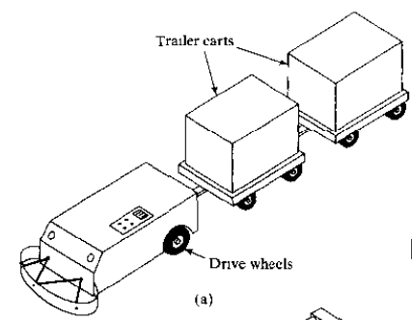
Driverless trains.
Trains consisting of five to ten trailers is an efficient transport system.

Slide 8
Automated Guided Pellet Trucks.
Automated guided pellet trucks are used to move palletized loads along predetermined routes.
In the typical application, the vehicle is backed into the loaded pallet by a human worker who steers the truck and uses its forks to elevate the load slightly.
Then the worker drives the pallet truck to the guide path, programs its destination, and the vehicle proceeds automatically to the destination for unloading.

Slide 9
Automated Guided Pellet Trucks.
The capacity of an AGVs pallet truck ranges up to several thousand kilograms, and some trucks are capable of handling two pallets rather than one.
A more recent introduction related to the pallet truck is the fork lift AGV.
This vehicle can achieve significant vertical movement of its forks to reach loads on racks and shelves.

Slide 10
Automated Guided Pellet Trucks.

Slide 11
AGV Unit Load Carriers
AGV unit load carriers are used to move unit loads from one station to another.
They are often equipped for automatic loading and unloading of pallets or tote pans by means of powered rollers, moving belts, mechanized lift platforms, or other devices built into the vehicle deck.
Variations of unit load carriers include light load AGVs and assembly line AGVs.

Slide 12
AGV Unit Load Carriers
The light load AGV is a relatively small vehicle with corresponding light load capacity (typically 250 kg or less).
It does not require the same large aisle width as a conventional AGV.
APPLICATION
Light load guided vehicles are designed to move small loads (single parts, small baskets or tote-pans of parts etc.) through plants of limited size engaged in light manufacturing.

Slide 13
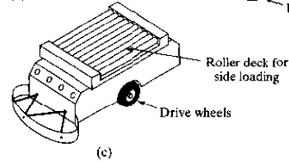
AGV Unit Load Carriers
An assembly line AGV is designed to carry a partially completed subassembly through a sequence of assembly workstations to build the product.

Slide 14
Applications of AGVs
Automated guided vehicle systems are used in a growing number and variety of applications.
previously described applications.
An other application area is in storage and distribution.
Unit load carriers and pallet trucks are typically used in these applications, which involve movement of material in unit loads.

Slide 15
Applications of AGVs
The applications often interface the AGVS with some other automated handling or storage system such as an automated storage/retrieval system in a distribution center.
The AGVS delivers incoming unit loads contained on pallets from the receiving dock to the AS/RS, which places the items into storage, and the AS/RS retrieves individual pallet loads from storage and transfers them to vehicles for delivery to the shipping dock.

Slide 16
Applications of AGVs
Storage/distribution operations also include light manufacturing and assembly plants in which work-in-process is stored in a central storage area and distributed to individual workstations for processing.
Electronics assembly is an example of these kinds of applications.
Components are "kitted'' at the storage area and delivered in tote pans or trays by the guided vehicles to the assembly workstations in the plant.
Light load AGVs are the appropriate vehicles in these applications.

Slide 17
Assembly line Applications of AGVs
AGV systems are used in assembly line applications, based on a trend that began in Europe.
Unit load carriers and light load guided vehicles are used in these lines.
In the usual application, the production rate is relatively low (the product spending perhaps 4-10 min per station), and there are several different product models made on the line, each requiring a different processing time.

Slide 18
Assembly line Applications of AGVs
Workstations are generally arranged in parallel to allow the line to deal with differences in assembly cycle time for different products.
Between stations, components are kitted and placed on the vehicle for the assembly operations to be performed at the next station.
The assembly tasks are usually performed with the work unit on-board the vehicle, thus avoiding the extra time required for unloading and reloading

Slide 19
Application in FMS
Another application area for AGVs technology is flexible manufacturing systems (FMSs).
In the typical operation, starting work parts are placed onto pallet fixtures by human workers in a staging area, and the AGVs deliver the parts to the individual workstations in the system.

Slide 20
Application in FMS
When the AGV arrives at the assigned station, the pallet is transferred from the vehicle platform to the station (such as the worktable of a machine tool) for processing.
At the completion of processing, a vehicle returns to pick up the work and transport it to the next assigned station.
An AGVS provides a versatile material handling system to complement the flexibility of the FMS.

Slide 21
Application in Hospitals & Office Mails
Other applications of automated guided vehicle systems include office mail delivery and hospital material transport.
Hospital guided vehicles transport meal trays, linen, medical and laboratory supplies, and other materials between various departments in the building.
These transports typically require movement of vehicles between different floors in the hospital, and hospital AGV systems have the capability to summon and use elevators for this purpose

Slide 22
AGVs interface with Robot
AGVS technology is still developing and the industry is continually working to design new systems to respond to new application requirements.
An interesting example that combines two technologies involves the use of a robotic manipulator mounted on an automated guided vehicle to provide a mobile robot for performing complex handling tasks at various locations in a plant.
These robot-vehicles have potential applications in cleaning rooms & in the semiconductor industry.

Slide 23
Analysis of vehicle based system

Slide 24
Available Time per hour per vehicle

Slide 25
Rate of delivery per vehicle

Slide 26
Required Work Load
Number of Vehicles required

Slide 27
Example#01
An automated guided vehicle system is being planned for a warehouse complex. The AGVs will be a driverless train system, and each train will consist of the towing vehicle plus four pulled carts. The speed of the trains will be 160ft/min. Only the pulled carts carry loads.
The average loaded travel distance per delivery cycle is 2000 ft and empty travel distance is the same. Anticipated travel factor =0.95. The load handling time per train per delivery is expected to be 10 min, If the requirements on the AGVs are 25 cart loads/hr, determine the number of trains required. Assume A = 1.0

Slide 28
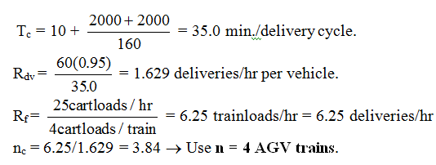
Solution

Slide 29
Example#02
An AGVS has an average loaded travel distance per delivery = 400 ft. The average empty travel distance is not known. Required number of deliveries per hour = 50. Load and unload times are each 0.6 min and the AGV speed = 125 ft/min.
Anticipated traffic factor = 0.85, availability = 0.95, and efficiency = 1.0. Develop an equation which relates the number of vehicles required to operate the system as a function of the average empty travel distance L_{e}.

Slide 30
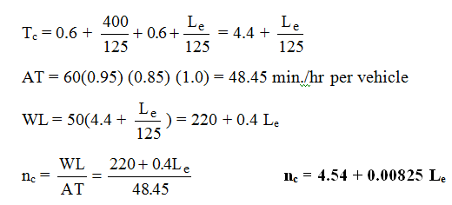
Solution

Slide 31
Assignment and Quiz 3
Problem | Group
10.3, 10.16 | 1
10.4, 10.15 | 2
10.5, 10.14 | 3
10.6, 10.13 | 4
10.7, 10.12 | 5
10.8, 10.11 | 6
10.9, 10.10 | 7
10.17 | -

Slide 32
Vehicle Guidance Technology
Three technologies that are used in commercial systems for vehicle guidance:
imbedded guide wires,
(2) paint strips,
(3) self-guided vehicles.

Slide 33
Imbedded Guide Wires and Paint Strips.
electrical wires are placed in a small channel cut into the surface of the floor.
The channel is typically .3-12 mm wide and 11-26 mm deep.
The guide wire is connected to a frequency generator, which emits a low-voltage, low-current signal with a frequency in the range 1-15 kHz.

Slide 34
Imbedded Guide Wires and Paint Strips.
This induces a magnetic field
along the pathway that can be followed by sensors on-board each vehicle.

Slide 35
Imbedded Guide Wires and Paint Strips.
When paint strips are used to define the pathway, the vehicle uses an optical sensor system capable of tracking the paint
The strips can be taped, sprayed, or painted on the floor.
Paint strip guidance is useful in environments where electrical noise renders the guide wire system unreliable or when the installation of guide wires in the floor surface is not practical.

Slide 36
Self-guided vehicles (SGVs)
SGVs operate without continuously defined pathways.
use a combination of dead reckoning and beacons located throughout the plant,

Slide 37
Self-guided vehicles (SGVs)
Dead reckoning refers to the capability of a vehicle to follow a given route in the absence of a defined pathway in the floor.
Movement of the vehicle along the route is accomplished by computing the required number of wheel rotations in a sequence of specified steering angles.
The computations are performed by the vehicle's on-board computer.
positioning accuracy of dead reckoning decreases with increasing distance.

Slide 38
Self-guided vehicles (SGVs)
the location of the self-guided vehicle is periodically verified by comparing the calculated position with one or more known positions.
These known positions are established using beacons located strategically throughout the plant.

Slide 39
Vehicle Management
Traffic Control.
On board Vehicle Sensing
Zonal Control
Vehicle Dispatching.
Remote call station

Slide 40
Safety
An inherent safety feature of an AGV is that its traveling speed is slower than the normal walking pace of a. human.
automatic stopping of the vehicle if it strays more than a short distance, typically 50-150 mm
vehicles are programmed either to stop when an obstacle is sensed ahead or to slow down.
When the safety bumper makes contact with an object, the vehicle is programmed to brake immediately.

